Slide 1
Module-4
Environmental Pollution
Dr. Sr. Vidhya Francis
PG Department of Chemistry

Slide 2
Pollution is the introduction of contaminants into a natural environment that causes instability, disorder, harm or discomfort to the ecosystem
Pollution

Slide 3
Types of pollution
Air Pollution
Water Pollution
Noise Pollution
Thermal Pollution
Soil Pollution
Radioactive Pollution
Light Pollution

Slide 4
Air Pollution - The release of chemicals and particulates into the atmosphere. Common gaseous air pollutants include CO, SO₂, chlorofluorocarbons (CFCs) and nitrogen oxides produced by industries and motor vehicles.
Water Pollution – By the release of waste products and contaminants into surface runoff into river drainage systems, leaching into ground water, waste water discharges etc.
Noise Pollution - which encompasses roadway noise, aircraft noise, industrial noise etc.
Thermal Pollution - It is a temperature change in natural water bodies caused by human influence, such as use of water as a coolant in a power plant.
Soil Pollution – It occurs when chemicals are released by underground leakage. Most significant soil contaminants are hydrocarbons, heavy metals, herbicides, pesticides and chlorinated hydrocarbons.
Radioactive Pollution – resulting from 20th century activities in atomic physics, such as nuclear power generation and nuclear weapons research, manufacture and exploitation.
Light Pollution - It includes light trespass, over-illumination etc.

Slide 5
Air Pollution
Contamination of the atmosphere caused by the discharge of a wide range of toxic airborne substances is termed air pollution. Human beings can live for weeks without food, for several days without water, but for only minutes without oxygen. Thus air is a resource and air quality is something that needs to be preserved.

Slide 6
Air Pollutants
Primary Pollutants
Harmful chemical substance that directly enters into the environment as a result of natural events and human activities eg: CO,CO₂,NO,SO₂ etc
Secondary Pollutants
These are substances that are produced in the air by the interaction of two or more primary pollutants . eg: hydrocarbons HN0₃, H₂SO₄ etc
Biodegradable Pollutants
eg: domestic sewage, food waste
Non-Biodegradable Pollutants
eg: Hg, lead salts, DDT

Slide 7
Major Air Pollutants
Five primary pollutants that are responsible for 90% of global air pollution are,
Carbon oxides (CO & CO₂)
Nitrogen oxides (NOx)
Sulphur oxides (SOx)
Hydrocarbons
Particulates

Slide 8
Oxides of Carbon ( CO & CO₂)
(A) Carbon monoxide (CO)
It is a colorless, odorless gas which is highly toxic to humans. It is the most serious pollutant.
Sources:
It is a product by incomplete combustion of fuel such as natural gas, coal or wood. Vehicular exhaust is a major source of carbon monoxide. Volcanic eruptions, forest fires, natural gas emission and smoking also contribute in the formation of CO.
Sink of CO:
Some soil microorganisms act as the sink of CO. In the presence of these microorganisms CO is either oxidised to CO₂ or reduced to methane.
CO + 1/2 O₂ → CO₂
CO + 3H₂ → CH₄ + H₂O

Slide 9
Effects of CO:
CO when inhaled reduces the O₂ carrying capacity of the blood. CO has the capacity to bind itself to hemoglobin much more strongly than oxygen forming carboxyhaemoglobin. This restricts the transport of O₂ to cells.
Reduces vision, causes cardiovascular disorders. CO inhibits the nitrogen fixation ability of bacteria.
Control measures for CO:
As the main source is vehicular exhaust, efforts are being made to improve the functioning of gasoline internal combustion engines so as to avoid the incomplete combustion of the fuels. Catalytic converters are also used in vehicles to oxidise CO.

Slide 10

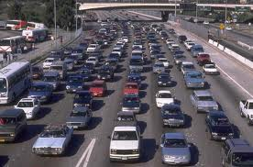


Sources of CO

Slide 11
(B)Carbon dioxide (CO₂)
A colorless, odorless, non-toxic green house gas
Sources:
It is emitted from combustion, cement production, respiration and decomposition of limestone to lime.
Sink of CO₂:
In a balanced ecosystem, CO₂ released into the atmosphere is consumed by the green plants for photosynthesis. Another sink for CO₂ is the ocean. Oceans contain large amounts of dissolved CO₂ in the form of carbonates and bicarbonates.
Effects of CO₂:
Respiratory disorders and suffocation, Global warming.
Control:
By afforestration, replacement of fossil fuels by other sources, using catalytic convertors in vehicle etc.

Slide 12
II. Oxides of Nitrogen
The environmental pollutants coming under oxides of nitrogen include nitric oxide (NO) and nitrogen dioxide.
Sources:
Natural sources:
During lightening discharge, atmospherec N₂ combines with O₂ to form NO.
2N₂ +O₂ → 2 NO
2NO + O₂ → 2NO₂
Other sources:
1. Combustion of fossil fuels such as coal, diesel, petrol etc.
2. Chemical industries like H₂SO₄ & HNO₃ produces NO as byproduct
Sink for NO_{x}
Oxides of Nitrogen undergo natural as well as photochemical reactions and get converted to HNO₃.
2NO + O₂ → 2NO₂
4NO₂ + 2H₂O + O₂ → 4 HNO₃
NO₂ + O₃ → NO₃ + O₂
NO₂ + NO₃ → N₂O₅
N₂O₅ + H₂O → 2HNO₃

Slide 13
Effects of NOx
    1. NO₂ is highly toxic
    2. Causes inflammation of lung tissues
    3. Higher doses cause bronchitis and respiratory problems
    Overexposure can cause death.
    Causes acid rain
Control of NOx
Use catalytic converter in automobile exhaust to convert oxides of N₂ to free N₂.

Slide 14
III. Oxides of Sulphur (SO₂ (97-99%) & SO₃ (1-3%))
SO₂ is the second most contributor of air pollutant. It is a colourless, heavy water soluble gas with pungent smell.
Sources:
Volcanic eruptions, Coal combustion, Industrialization, Automobile pollution, Petroleum Refining, manufacture of sulphuric acid, paper making etc.
Sink for Sox
H₂SO₄ in the form of acid rain may react with NH₃ and with limestone or marble.
Effects of SOx
1. Tend to irritate the mucous membranes of the respiratory tract
2. Higher concentration causes bronchitis
3. SO₂ is responsible for acid rain which damages plants and aquatic life.
4. Causes acid rain
5. Marbles and mortar statues are affected

Slide 15
Control of Sox
1. Removal of S from fuel before combustion
2. Removal of SOx from flue gases using chemical scrubbers
3. Using low sulphur or sulphur free fuels like natural gas
4. By using hydroelectric power or nuclear power in place of thermal power.

Slide 16
IV. Hydrocarbons
Methane is the most abundant hydrocarbon pollutant. Other hydrocarbon pollutants are ethane, ethylene, acetylene etc.
Natural Sources
Anaerobic decomposition of organic matter
Trees emit large amount of hydrocarbons into the air.
Petroleum burning, gas and oil production, Coal,wood burning,evaporation of solvents
Sink
Hydrocarbons are susceptible to oxidation through a series of steps of chemical and photochemical reactions leading to the formation of CO₂ or other water soluble products which are washed away by rain.

Slide 17
Effects
1. Due to their photochemical reactions with oxygen and nitrogen oxides they undergo oxidation and form photochemical smog.
2. Carcinogenic effects
Control
Exhaust gases of automobiles can be controlled by having a catalytic converter which helps in the oxidation of hydrocarbons to CO₂ and water.

Slide 18
Particulates
The small, solid particles and liquid droplets suspended in air are called particulates. Soot, fly ash, dust, mist etc are the main particulate matter in atmosphere.
Sources:
Natural processes like volcanic eruption, blowing of dust by wind, spraying of salt and other solid particles by the seas, and oceans.
Anthropogenic sources like fly ash from power plants, mining operations, smoke from incomplete combustion processes, burning of wood etc.
Effects
1. Inhalation of small particles irritates the lungs
2. Pulmonary fibrosis in mine workers
3. Some particulate are carcinogenic.
4. Causes climatic changes, reduces visibility
Control
Wet scrubbers are used to remove solid, liquid gaseous contaminants
Gravity settling chamber.

Slide 19
Control of Air Pollution
Methods to control gaseous pollutants
Combustion: This technique is used in case of organic pollutants. On catalytic combustion or flame combustion these pollutants are converted into CO₂ and H₂O.Equipments used: flame incinerators, steam injection etc.
Absorption: This method is used to remove pollutants like fluorides,H₂S,SOx,NOx from gaseous pollutants. They are passed through the scrubbers or suitable liquid absorbents like water, aqueous alkalies, dil HNO₃ etc.
Adsorption: This technique involves the passage of gaseous pollutants through porous solid adsorbents like silica gel, alumina, zeolites, activated carbon etc. The pollutants get adsorbed at the surface of the solid adsorbents by physical or chemisorption. Oxides of nitrogen and sulphur can be adsorbed on silica gel, zeolites etc.

Slide 20
II. Methods to control particulates
The device used is based upon the size, shape and hygroscopic properties of the particulates concerned .
Gravity settling chamber
Cyclone Collector
Electrostatic Precipitator
Wet scrubber

Slide 21
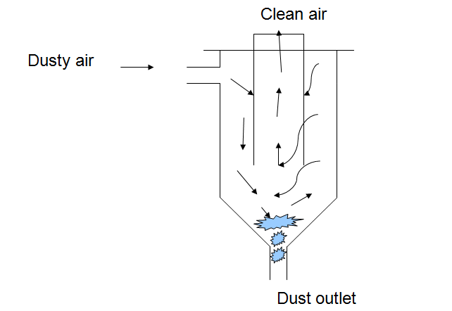
This chamber collects the particulate matter by gravity. Effluent gases are led into the chamber where the velocities of these gases decrease so that dust particles get settled. This method is not suitable for finer particles which require longer settling time.
1.Gravity settling chamber

Slide 22
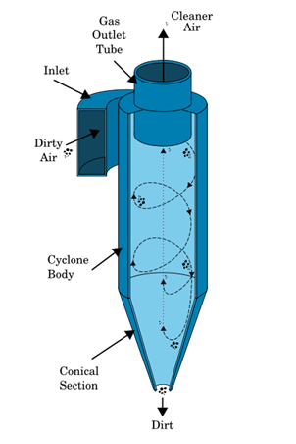
2.Cyclone Collector
In this technique the polluted air is passed through a metallic chamber at high speed. The basic principle underlying the cyclone collector is that a gas flowing into a tight circular spiral at high speed produces centrifugal force on the suspended particles. The centrifugal force thus produced, forces the suspended particles to move away from the gas stream towards the wall, strike the wall of the cylinder and fall at the bottom. This method removes 50-90 % of large particulates along with a few medium and small particulates.

Slide 23
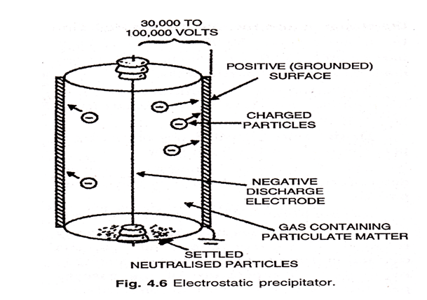
3.Electrostatic Precipitator
In electrostatic precipitators, the flue gases are passed through tall chamber fitted with two electrodes. Out of these electrodes the peripheral electrode is earth connected while the central one is subjected to a very high potential. Due to very high potential difference, the air inside get ionised to give free electrons and positively charged ions, This free electrons are taken up by the particulates and acquire negative charge. These negatively charged particles get attracted towards the positively charged peripheral electrode, lose their charge and fall down at the bottom.

Slide 24
Here the exhaust gases stream containing the particulates is allowed to pass through a fine spring of water. This helps to remove particulate matter as well as some gaseous pollutants.
4.Wet scrubber:

Slide 25
III. Methods to control automobile pollution
1. Modification of engine design
The emission from automobile engines is due to the incomplete combustion of fuel. Thus engine designs are modified so as to avoid the incomplete combustion of fuel.
2. Use of catalytic converter
Automotive exhausts pollutants can also be controlled by installing catalytic converters in the exhaust system. It is a device which runs exhaust gases of automobiles through a bed of alumina pellets coated with platinum or palladium catalyst. This will convert CO, and unburnt hydrocarbons into CO₂ and H₂O and nitrogen oxides into nitrogen.

Slide 26
Water Pollution
Water pollution is defined as the contamination with any foreign substances or heat that is harmful to the living organisms.
Types of water pollutants
    Inorganic pollutants
    Organic pollutants
    Radioactive pollutants
    Thermal pollutants

Slide 27
1.Inorganic Pollutants
These include heavy metals such as Cd, Pb, Hg, metal salts, ammonia, fertilizers, sediments etc.
1.Cadmium
Water containing more than 0.01ppm Cd is unfit for drinking.
Sources
During extraction of Zinc, cadmium is released to the environment as a by-product. Rechargeable Nicad batteries are used in calculators, satellites, missiles etc. Cadmium alloys are used in solders, valve seals, and high pressure containers. These utilities after serving their term are disposed of by burning in waste incinerators. As a result, Cd is released to the atmosphere but subsequently rained down into aquatic systems.
Effects:
Cd-Replaces Ca in the bones and rheumatism set in. Consumption of sea food contaminated with Cd leads to enzyme poisoning. Workers engaged in Cd related industries are more likely to suffer from cancer.

Slide 28
2. Lead
Sources
The main sources of lead pollution are,
1.automobile emissions 2. Mining
3. burning of coal and oil 4.lead smelters
Effects
    Liver-kidney damage
    Gastrointestinal damage
    Mental retardation in children
    Abnormalities in fertility and pregnancy

Slide 29
3.Mercury
Sources:
volcanic lava
2. electronic equipments
3. plastic and paper industries
4. fungicides
5. amalgam tooth fillings, broken thermometers
Effects:
Paralysis, blindness, chromosome breakage , birth defects, depression
Minnamata disease is due to mercury poisoning.

Slide 30
4.Waste from Fertilizer plants
Sources:
Wastes from fertilizer plants contain ammonia, nitrates, phosphates etc.
Effects:
When released into water system, they lead to accumulation of nitrates and phosphates in water and causes eutrophication. When such water is used by human beings, nitrates are reduced to nitrites by intestinal bacteria which cause methomoglobinaemia in children.

Slide 31
5.Sediments:
Sources:
Organic and mineral solids etc
Effects:
These can block water flow and make water muddy and cloudy and make unfit for domestic and industrial purposes

Slide 32
2.Organic Pollutants
Organic pollution is the most common form of water pollution. It is caused by the naturally occurring compounds like proteins, carbohydrates, fats etc. as well as by synthetic compounds like pesticides, herbicides etc. The organic pollutants originate mainly from domestic sewage, industrial effluents and farm wastes.
Domestic waste: It consists mainly sewage which has largely organic matter in it.
Infectious agents: sewage from municipalities is associated with disease causing microorganisms which causes Typhoid, cholera, dysentry etc
Organic chemicals: These include organic chemicals like Pesticides,fertilizers, detergents, solvents etc: Most of these chemicals are toxic in nature. eg: DDT, endosulphan etc.

Slide 33
3.Radioactive Pollutants
3.Radioactive Pollutants
Radioactive pollutants: Sr⁹⁰, Cs¹³⁷, Pu²⁴⁸ etc
Sources:
Nuclear power plants, nuclear reactors, wastes of uranium and thorium mining and refining, use of radio isotopes in research, agricultural, industrial and medical applications eg: C¹⁴, P³², Co⁶⁰, I¹³¹ etc
Effects:
Radiations from radioactive materials can affect cancer, burns and molecular disruptions. High energy radiations can harm the genetic material, especially the chromosomes of the living organisms.

Slide 34
4.Thermal Pollutants
The discharge of waste heat into natural waters is termed as thermal pollution.
Sources:
Water used as coolants in nuclear power plants, thermal power plants, industries is returned to water body at a high temperature. Thus causing a progressive warming of the water body. This phenomenon is known as thermal pollution.
Effects:
1. Decreases the amount of oxygen dissolved which affects aquatic life.
2. Disease resistance of fish decreases.
3. Pollutants in water become more toxic.

Slide 35
Control of water pollution
1. Reduction of waste at source by trapping nutrients, proper aeration etc
2. Pollutants like mercury, sodium, ammonia, phenols should be removed by adsorption, electrolysis, reverse osmosis, ion exchange etc.
3. Sewage should be given proper treatment before its discharge into water bodies.
4. Pathogens are removed from water by disinfection.
5. To avoid thermal pollution the waste heat should be transferred by using cooling towers
6.Warm water is stored in earth dike ponds, after bringing down the temperature and then discharged into water body.

Slide 36
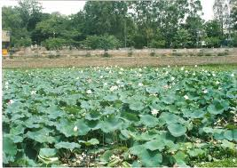
Eutrophication
A condition of lake or reservoirs involving excess algal growth
Due to the introduction of nutrients such as nitrates, phosphates through land runoff, fertilizer effluents

Slide 37
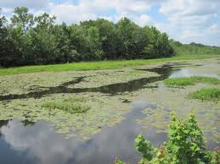
Major culprit -presence of phosphates
House hold detergents are a common source of phosphates
Growth of pathogenic organisms due to the decrease of dissolved O2,increase of turbidity

Slide 38
Effects:
Growth of pathogenic organisms due to the decrease of dissolved O₂, increase of turbidity. Increase in the rate of sedimentation, shortening of the life span of lakes, obstruction of flow of water etc.
Control:
Major culprit in the excessive eutrophication is the presence of phosphates in water. House hold detergents are a common source of phosphates in waste water. Hence, to control eutrophication, entry of phosphates must be prevented from bodies of water.

Slide 39
Desalination of Water
Water containing high concentration of dissolved salts is called Brackish water. It is unfit for drinking. Eg: sea water containing 3.5% of salts .The process of removal of dissolved salts from water is known as desalination.
The desalination can be done by elecrodialysis and reverse osmosis.

Slide 40
Electrodialysis
In this method, the cations and anions present in the brackish water are pulled out by passing electric current through it. The electrodialysis cell consists of anode and cathode and ion selective membranes which are permeable to either anions or cations.
The anion selective membrane which are permeable to anions are embedded with positively charged species such as R₄N⁺. The cation selective membrane are embedded with negatively charged RSO₃⁻, RCOO⁻ groups and are permeable to cations only.
When an electric current is applied across the electrodes the cations (Na⁺ions) migrate towards the cathode and anions (Cl⁻ions) move towards the anode. Therefore the central compartment becomes free of Na⁺ and Cl⁻ ions and the concentration of ions on the side compartment increases and they are periodically replaced by saline water. Desalined water is drawn from the central compartment.

Slide 41
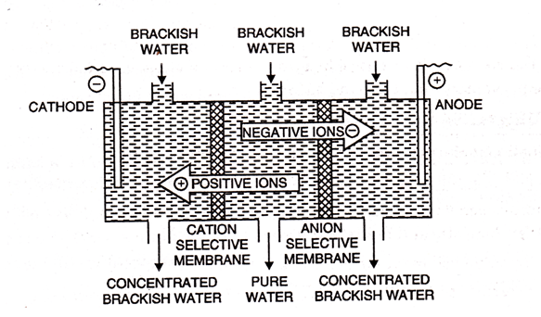

Slide 42
Reverse Osmosis
Osmosis is the phenomenon by virtue of which flow of solvent takes place from a region of low concentration to high concentration when two solutions of different concentrations are separated by a semi-permeable membrane. The pressure necessary to just prevent the flow of solvent is known as osmotic pressure.
If a pressure greater than osmotic pressure is applied to the solution side, the flow of solvent is reversed, i.e. solvent from the solution moves to the solvent side. This process is reverse osmosis.

Slide 43
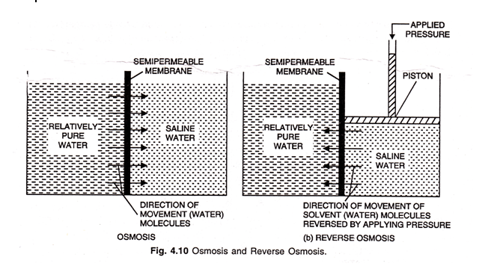
Advantages:
Desalination by reverse osmosis removes ionic impurities as well as colloidal silica.
Both organic and inorganic contaminants can be removed.
Operating expenses are low.
Energy requirement is 30% lower than that of distillation process.
Operated at a comparatively low temperature.

Slide 44


